Slide 1

Welcome to Business Strategy and Innovation

Slide 2
Welcome to Business Strategy and Innovation
LEARNING OBJECTIVES
To understand strategic management as a critical management process
To help the student appreciate how business strategy impacts their role as a manager.
To learn frameworks and models which assist in analyzing competitive situations and strategic dilemmas.
To understand the impact of internal and external factors on business strategy
To determine how to identify the sources of competitive advantage.
To understand innovation as a competitive weapon and to gain insights regarding challenges in managing innovation effectively to ensure a balance of short and long-term business priorities.
Notes:
To help the student better understanding of how business strategy in their firm impacts their role as manager in manufacturing and production
To understand strategic management as a critical management process.
To learn frameworks and models which assist in analyzing competitive situations and strategic dilemmas.
To understand the impact of internal and external factors on business strategy
To understand the sources of competitive advantage.
To understand innovation as a competitive weapon and to gain insights regarding challenges in managing innovation effectively to ensure a balance of short and long-term business priorities.

Slide 3
Welcome to Business Strategy and Innovation
MODULE STRUCTURE
Topic 1: Introduction to Business Strategy
Topic 2: The Strategic Management Process
Topic 3: External Analysis
Topic 4: Internal Analysis
Topic 5: Formulating Business Strategies
Topic 6: Formulating Corporate Strategies
Topic 7: Strategy Implementation
Notes:
Topic 1: Introduction to Business Strategy
Topic 2: The Strategic Management Process
Topic 3: External Analysis
Topic 4: Internal Analysis
Topic 5: Formulating Business Strategies
Topic 6: Formulating Corporate Strategies
Topic 7: Strategy Implementation

Slide 4


Welcome to Business Strategy and Innovation
HOW TO GET THE MOST OUT OF THIS MODULE
Review the pre-reads before viewing the video lectures. Continue to reference the pre-reads as necessary. Complete the topic assignments and homework.
If you are not a full time student ask around your firm to learn how the concepts described in this module play out in your organization. Study your firm’s website, read its annual reports, and press releases. Use insights gained to complete the lesson assignments
Relate the concepts discussed to the role of data analytics in optimizing firm performance
Notes:
Okay before you start this module by hitting the play button for the next video let me suggest …….
Pre-reads Include Course packs from McGraw-Hill and the Harvard Business School; website links for Free Supporting Content; and Selected YOUTUBE Videos. See Course website for specifics.
Leverage but expand your current network of relationships around the organization to learn more about other parts of the business function. Hopefully you have started doing this concurrent with the Financial and Managerial Accounting, Financial Management, and Marketing topics. Get to the point where you understand strategies pursued by these different functional areas and how they interrelate with manufacturing and production.
Share your experiences with you class mates …….

Slide 5


How Does One Get “Good” at Strategy?
Welcome to Business Strategy and Innovation
Learn the tools and basic concepts
Develop your business acumen and understand the industry in which your firm operates.
Know and use good sources of industry-related content.
Broaden your perspectives.
Practice
Notes:
Use the medical analogy here
Processes and tools are very helpful but what’s important are the knowledge, skills, and abilities of the strategist. So how do you become a good strategist?
First Become a student of your industry, then ultimately a though leader in your firm
Understand 1) who are the key players, 2) what are they good at, 3) what do customers want and value and how are these needs met, 4) who has competitive advantage and why, 5) what current strategies and business models appear to be winning, and 6) what solutions are likely to be on the horizon.
"... By investing time and energy to reflect on the situations and decisions that face you; by finding ways to connect ideas and people that you had never linked before; and by having the courage to make choices about what you will do and what you won’t, you will greatly increase your strategic contribution..."
So the keys to improving one's strategic thinking is:
1) reflect on situation and decisions;
2) create connections between ideas, plans and people;
3) ability and willingness to make choices;
Meanwhile, I like to append three more articles, with two from HBR, for your reading:
Here's a simple exercise that will make a huge difference if you persist with it: Whenever you are in a cafe, dentist or other professional waiting room, or anywhere else where there are magazines to read, pick up a magazine you would not normally read! Ideally this will be from an industry different to your own (avoid tabloids and gossip magazines). Pick one or two articles and read them. Do the same thing on-line. Twice a week, search a different industry and read a couple of updates or news items. In just a short while you will be gaining a broad perspective of what is going on, what's being developed and what other's are focussing on. After reading each item, ask yourself how this information might impact your organization now or in future, and/or how you could use this idea in your own organization. This will help you to think strategically, and also come up with 'new' ideas for your own organization and industry. There are lots of others but this one is no-cost and simple to implement.

Slide 6
Introduction to Business Strategy
What is Planning and Why is it Important

Slide 7
Business Strategy and Innovation
Introduction to Business Strategy
Topic Objectives
To discuss the overall Management Process and to define the role of strategy in creating and sustaining a competitive advantage in the marketplace
To describe the different types of planning that occurs at each level of the management hierarchy
To explain the difference between a business strategy and a firm’s business model and the importance of ensuring that each are aligned with the other
Notes:
Strategy/Superior Performance
Role of management
Business Models
Close with

Slide 8
Business Strategy and Innovation
Introduction to Business Strategy
Lessons
What is Planning and Why is it Important
Types of Plans
What is Business Strategy
The Business Model
Levels of Strategy
Notes:
5 Topics
So Let begin with

Slide 9
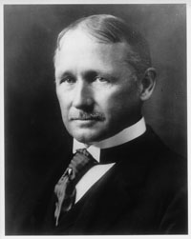
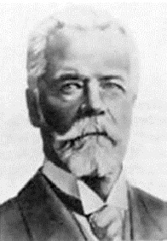
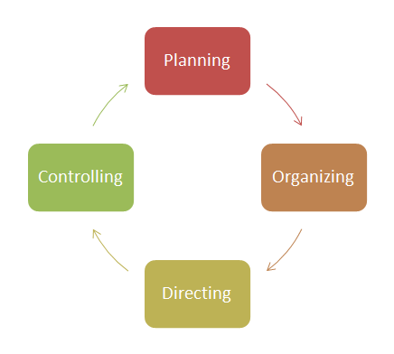
What is Planning
Defines organizational objectives and goals
Develops overall strategies, tactics, and activities necessary to achieve the goals
Creates a hierarchy of plans that guides the firm at each level of the organization
Taylor
Fayol
The Management Process
Notes:
Planning is defining organizational goals, establishing a strategy for reaching those goals, and developing a comprehensive hierarchy of plans to integrate and coordinate activities. It can be either formal or informal, depending on the time frame and amount of documentation
General and industrial administration
5 Functions of Management by Henri Fayol
Planning
Managers must plan for future conditions, develop strategic objectives and secure the achievement of future goals. Therefore, managers must evaluate future contingencies affecting the organization, and shape the future operational and strategic landscape of the company.
Organizing
Managers must organize the workforce in an efficient manner and structure and align the activities of the organization. Managers must also train and recruit the right people for the job, and always secure a sufficiently skilled and educated workforce.
Commanding
Managers must supervise subordinates in their daily work, and inspire them to achieve company goals. Likewise it is the responsibility of managers to communicate company goals and policies to subordinates. The commanding of subordinates should always be consistent with company policies, and every manager should treat subordinates in line with the standards of the company.
Coordinating
Managers must harmonize the procedures and activities performed by the company, meaning that every activity of each organizational unit should complement and enrich the work of another.
Controlling
Managers must control that company activities are in line with general company policies and objectives. It is also the responsibility of the manager to observe and report deviations from plans and objectives, and to make initiatives to correct potential deviations.

Slide 10
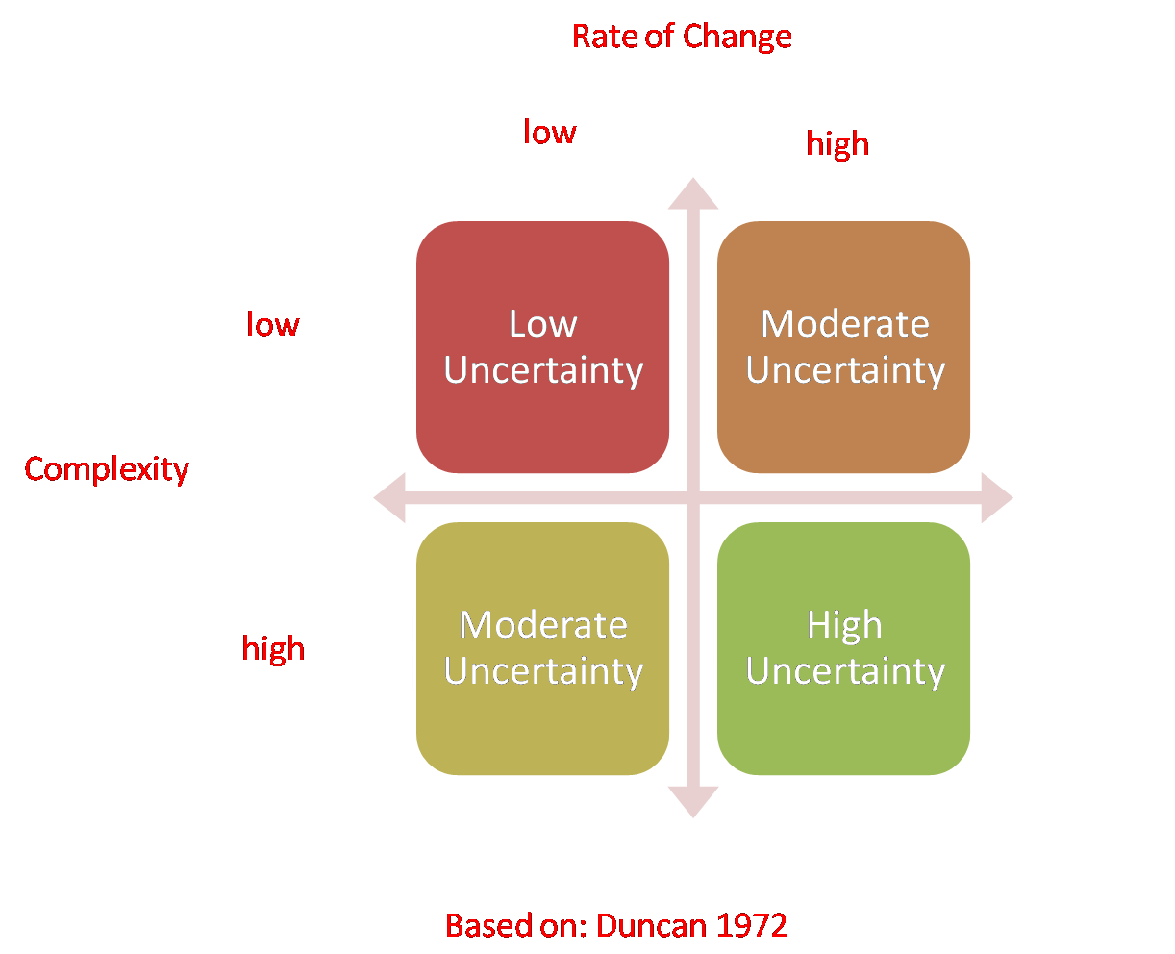
Why is Planning Important
Planning provides direction that can align all of the activities of the organization
Planning reduces uncertainty
Planning establishes organizational goals and standards
Planning can improve employee engagement throughout the organization

Slide 11
Factors That Affect Planning
Organizational Level
Impacts the type and scope of plan(s) prepared
Degree of Environmental Uncertainty
Impacts the planning methodology, specificity of the goals and the planning time horizon
Length of Future Commitments
Impacts the planning time horizon
Notes:
Organizational level impacts the type and the scope of plans prepared at that level.
Environmental uncertainty impacts the planning methods, planning horizon,
and the specificity of the goals being set.
And the length of future commitments also impacts the planning horizon.

Slide 12
Introduction to Business Strategy
Types of Plans

Slide 13

Types of Plans
Strategic
Functional
Operational/Tactical
Contingency
Notes:
Quick Overview (provide details later)

Slide 14
Types of Plans
Strategic Plans
Apply broadly to the entire organization. Developed at Corporate or Business Unit (“SBU”) Level. Are the responsibility of senior management.
Establish the organization’s overall mission, goals, and objectives. Goals tend to be directional rather than specific
Seek to position the organization in terms of its external of external environment. The focus is on creating and sustaining a competitive advantage
Are the basis for the functional plans which are typically developed concurrently with the SBU plans
Cover extended periods of time.

Slide 15
Types of Plans
Functional Plans
Planning related to a specific business functions. Examples:
R&D Marketing
Supply Chain Financial
Sales Manufacturing
Human Resources Logistics
Driven by goals developed in strategic planning, translated into more specific, operational goals at the business function level
Functional plans are interrelated and the development of functional plans are typically managed by a senior level executive committee
Responsibility of upper level middle management

Slide 16
Types of Plans
Operational Plans/Tactical
Narrow focus – usually apply to specific activities of the organization.
Examples:
Production schedules
Sales Call Schedules
Delivery schedules
Staffing Schedules
Project work plans
Budgets
Prepared daily, weekly, monthly and are often standing plans
Are developed at any managerial level but primarily the responsibility of first level supervisors and team leaders

Slide 17
Types of Plan Example of Cascading Goals
Strategic – Corporate Level
A 22% ROI corporate wide
Reported EPS growth between 14% and 16%
Strategic – Business Unit Level
Increased market share by 3%
Acquiring computer integrated manufacturing technologies
Functional Level – Marketing
Introducing 4 new products
Increase average price by 4%
Increase product sales by 7%
Operational Level
Meeting sales quota
Reducing spoilage by 3%

Slide 18
Types of Plans
Contingency Plans
Address the “What Ifs” - incorrect planning assumptions or the realization of known risks
When needed:
To mitigate a critical planning assumption or business risk
To minimize business disruption due to natural disasters; a failure in a critical production process; an labor action (strike); a supplier goes out of business; etc.)

Slide 19
Introduction to Business Strategy
What is Business Strategy

Slide 20
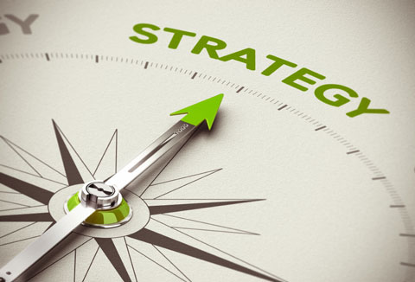
Strategic Planning
Business Strategy
The goal directed actions a firm intends to take in its quest to gain and sustain competitive advantage.
Notes:
The objective of strategy is to achieve superior performance in the arena, the marketplace. Strategy is about defeating the enemy – the competition
And the firm accomplishes that by creating and sustaining a competitive advantage
So lets focus on this term, competitive advantage for a moment.

Slide 21
Competitive Advantage
Competitive advantage is superior performance relative to other competitors in same industry
Competitive parity is when two or more firms in the same industry perform at the same level
Competitive disadvantage is firm underperformance relative to competitors in the same industry
A Competitive Advantage is NOT sustainable if the source of advantage can be independently attained or easily imitated
Approaches to Creating Competitive Advantage
Cost Leadership
Differentiation
Focus

Slide 22
Competitive Advantage
ROA
Delta Airlines 6.62%
United Continental 6.98%
American Airlines 8.67%
Southwest Airlines 9.41%
Accenture 16.34%

Slide 23
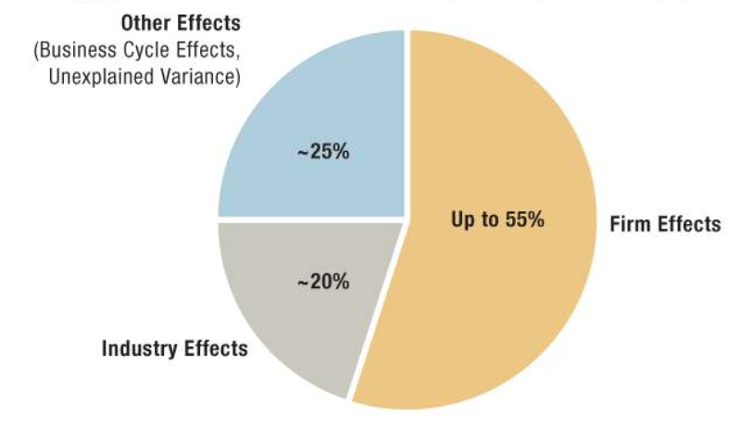
Drivers of Firm Performance
Firm effects result from the quality of the firm’s
Business Model and the alignment and effectiveness of firm Business Strategy
Source: Strategic Management Concepts and Cases by Frank K. Rothaermal
Notes:
This graphic illustrates the three
main drivers of firm performance,
the most important of which is firm specific effects,
which are driven by managerial action and decision-making.
In short, firm effects are the result of the inner play
and the align with the strategy
and the firm's business model.
A firm's business model is the result of prior
strategic choices made by management
that have resulted in the capabilities,
processes, systems and technology,
structure, partnership, products and services,
and customer relationships that are unique to the firm.
These effects along with the strategy and business model
together help explain superior performance
within the firm's industry.
Industry structure also impacts firm performance.
As an example, the structure of the airline industry is such
that firms find it difficult
to generate high and sustainable levels of profit.
Conversely, for software and consulting,
the industries are structured in a way
that's much more favorable to the competitors.
We'll discuss industry structure in detail in a later video,
but keep in mind two things.
Industry structure impacts average firm profitability and
astute managers through effective strategy
could often mitigate the negative effects
of industry structure.
Finally, economic and other uncontrollable macroforces,
such as political actions, technology disruptions,
and demographic and societal changes,
can also significantly impact firm performance.
These forces will often have different impacts
on different industries.
For example, consumer products firms
will be disproportionately affected by economic contractions
moreso than healthcare firms.

Slide 24
Introduction to Business Strategy
The Business Model

Slide 25
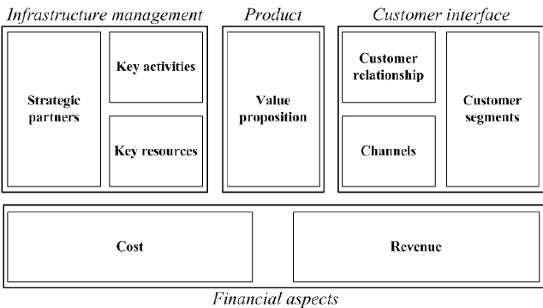
What is a Business Model
A firm’s BUSINESS MODEL is how the various components of the business fit together to produce a profit. A business model is the end results of decisions and tradeoffs made by management in formulating strategy
Typical Components of a Business Model:
Markets Service Served: Products (value propositions); Customer; Channels; and Relationships
Firm Infrastructure: Processes and technology; People and Culture; and Strategic Partnerships
Economic Model: Cost drivers and revenue models
Depiction of Alexander Osterwalder’s
Business Model Canvas
Notes:
Begin slide at :25 mark in video

Slide 26

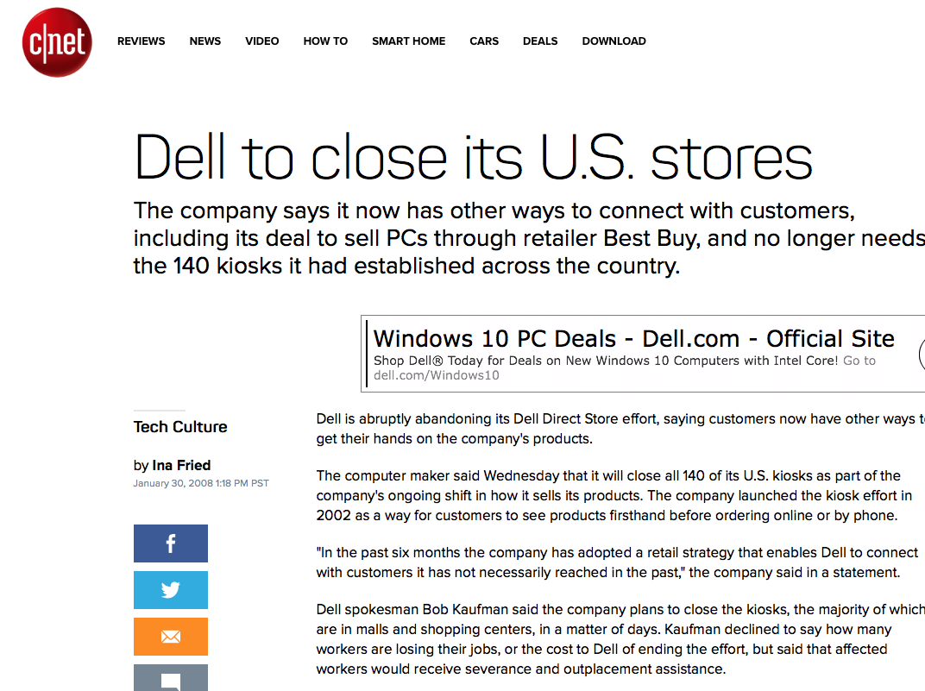
Business Models Align to Strategy
Cost-leadership strategy
Becoming the lowest-cost producer in an industry. Business model emphasis on use of technology to drive down operational costs, simple, standardized product designs, and a focus on driving costs down
Differentiation strategy
Attempting to be unique in an industry within a broad market. Making products unique to allow the company to charge a premium price. Creative design and clever marketing, emphasis on R&D and and higher quality inputs to create customer value
Focus strategy (Segmentation)
Attempting to establish an advantage (such as cost or differentiation) in a narrow market segment.
Notes:
Transition to slide at 1:48 mark in the recording

Slide 27
What is a Business Model Core Competencies
The core competencies of a firm are its unique capabilities and resources that enable the firm to deliver and support a value proposition to its customer
Capabilities consist of the firms resources and how those resources are combined and integrated into functional business processes and business activities that support the value proposition and competitive strategy
To be competitive a firm must have unique and valuable resources and the capability to exploit these OR a unique capability to manage a relatively common resource.
Notes:
Start slide at the 4:27 mark in the video
so a core competency or core capability is
a capability that is strong that directly supports
the firm's value proposition, and the resources themselves
directly support the activities and the capabilities.

Slide 28
Introduction to Business Strategy
SWA Business Model Case

Slide 29
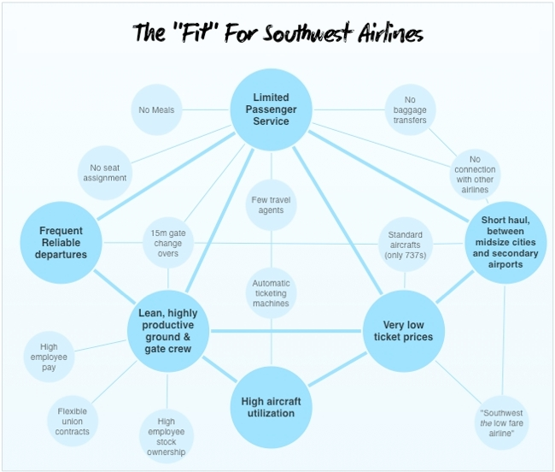

What is a Business Model Case Example
Positioning: Cost Leadership
Customer Strategy: Focus on short haul passenger who wants limited but reliable service at low ticket prices
Revenue: Ticket Revenues, In-Flight Sales
Capabilities and Resources:
Highly product ground and gate crews
Standard aircrafts (only 737s)
Point to Point rather than hub operations and very high aircraft utilization
Secondary airports
Spartan Headquarters
Simple Business Processes
Notes:
The diagram on the right is called an activity map.
An activity map is a diagnostic tool that can
be used to understand how an organization connects
its value proposition to the activities that enable
the organization to create a competitive advantage.
In the activity map, the darker circles represent
the foundations of the overall business model.
The higher order strategic themes, and the lighter
circles show how the strategy is implemented,
through clusters of tightly linked activities.

Slide 30
Recap – What is Business Strategy?
Strategy is the quest to gain and sustain competitive advantage.
It is the managers’ theories about how to gain and sustain competitive advantage.
It is about being different from your rivals.
It is about creating value while containing cost.
It combines a set of activities to stake out a unique position.
It must be aligned and leverage the firm’s business model
It requires long-term commitments that are often not easily reversible.

Slide 31
Introduction to Business Strategy
Levels of Strategy

Slide 32
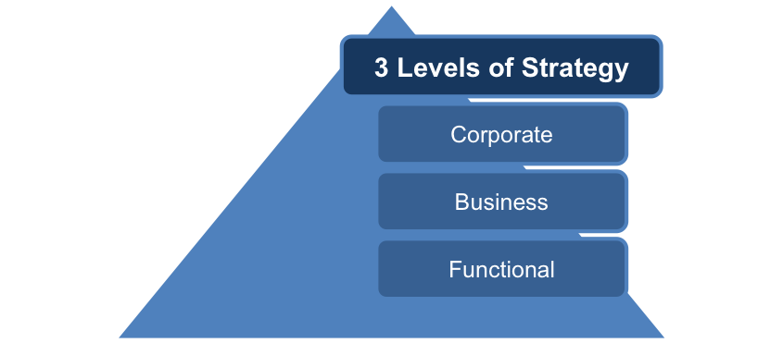
Levels of Strategy
Notes:
Transition to at the :07 mark in the video
And within the organization, strategy can be developed
at three levels, the corporate level,
which overarches the various lines of business
that the company has,
at the business unit level,
often referred to as the competitive level.
The business unit level is where products,
services, customers, and competitors exist,
and at the functional level.
Each business unit is gonna be comprised
of a number of functions.
Very typical in, say a manufacturing organization,
is that the business unit will be comprised
of manufacturing logistics,
R&D,
operations,
IT,
perhaps even some accounting functions.
Let's now talk about the type of strategy
that's developed at each of these three levels.

Slide 33
Levels of Strategy
Corporate Strategy – addresses which businesses an organization will be in; how resources will be allocated among those businesses; and how each business will relate to the other. Also sets the “grand strategy” – growth, stability, defensive – for each business unit.
Business Strategy – focuses on how to compete in a given business. Strategy here is about creating and sustaining a competitive advantage
Functional Strategy– concerned with the activities of the different functional areas of the organization and the short to long term methods to be used to help achieve the overall business strategy Example: Marketing develops a one to three year product development and roll-out plan that supports the overall business objective of 10% growth in overall revenues. The functional plan then can be divided into one year operation plans with budgets. Marketing may also develop other plans in areas such as distribution, promotion, and pricing
Notes:
Transition to this slide at the :56 mark in the video

Slide 34



Grand Strategies
Growth strategy
A strategy in which an organization attempts to increase the level of its operations
Stability strategy
A strategy that is characterized by an absence of significant change
Renewal strategy (defensive strategy)
A strategy characteristic of a company that is reducing its size, usually in an environment of decline. Sub strategies: Retrenchment, Turnaround, Divestiture, Liquidation
Notes:
Transition to this slide at the 3:55 mark in the video
An organization may choose to adopt a stability strategy
under a number of scenarios.
First, environmental turbulence may be such
that conditions are so uncertain
that it might convince corporate management
to be conservative until they become more certain
about directions in the market,
or, on the opposite spectrum, the environment
of turbulence might be so minimal
that the firm does not foresee any major threats
to itself, nor any need to adjust the strategy.
Another reason why you may implement a stability strategy is
that the organization may have just finished a period
of rapid growth and needs to consolidate its gains
before pursuing more growth.
Another reason is the industry itself might be instability,
with few or no growth prospects, and the firm is
currently in a comfortable position within that industry.

Slide 35
Growth Strategies
Concentration: growing by focusing on the firms core business – its primary business – and increasing the number of products or services offered or the number of markets served
Diversification: growing by moving into a different industry. Strategy here is typically determined at the corporate level
Vertical Integration: growing by gaining control over either the firms inputs (suppliers) or outputs (distributors/retailers). Growth through acquisition
Horizontal Integration: growing by combining with a competitor. May be an acquisition or merger
Notes:
Transition to the slide at the 7:51 mark in the video
This video needs to cut off at the 10:20 point.

